Slide 1




Data
Culture
society
@edCDCS
Notes:
MT

Slide 2
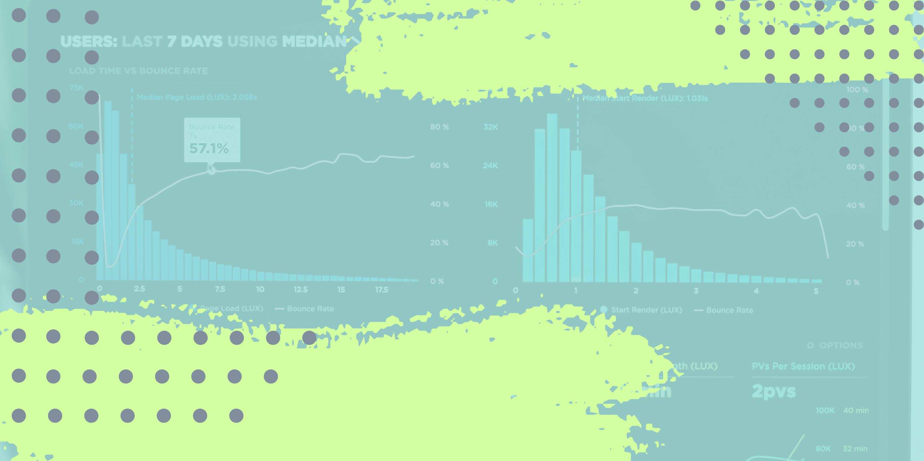

Principal
Component
analysis
19 May 2023
@edCDCS
Notes:
MT

Slide 3


Overview
Overview of the PCA Technique
Overview of the dataset and the question we are trying to answer to
Data Cleaning
PCA analysis
www.cdcs.ed.ac.uk

Slide 4
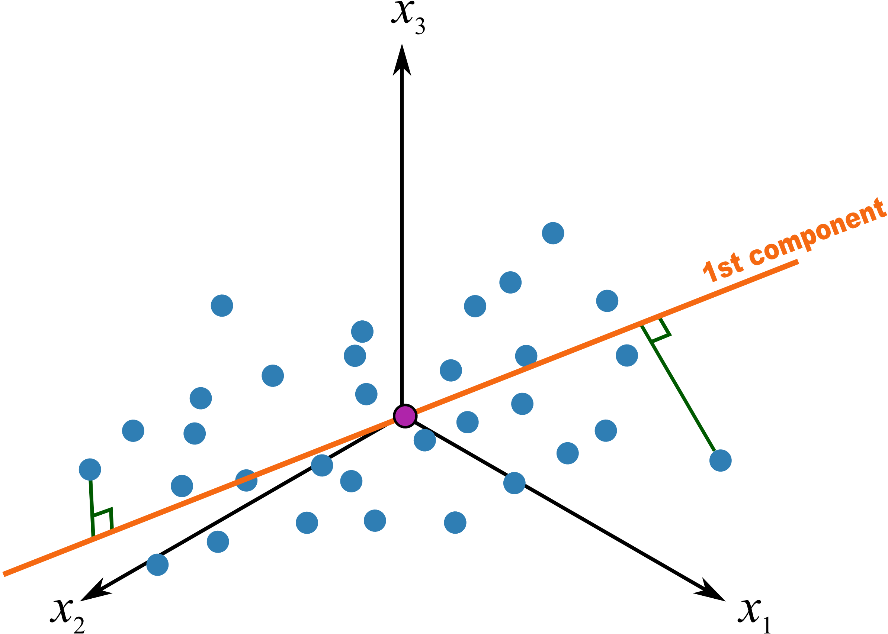
PCA
What Is PCA
(Principal Component analysis)?
It is a tecnique to observe on how more than 3 continous variable impact a dataset
What do you need
3 or more continuous variable
1 or more categorical variable (not mandatory)
Principles
It is based on linear regression
It will plot the best fitting line for describing the distributions
Line that minimise the distance from the regression line
Line that maximise the distances between the plotted values and the origin
Link to a video explaining the technique
Pull in the outliers by doing a log transformation of the continuous value
www.cdcs.ed.ac.uk
Notes:
Square the distances so that negative do not cancel positive than we sum them

Slide 5

PCA
terminology
SS(distances) -> Sum of the squared distanced need to be largest option and that will be PC1
PC1 -> Line where the sum of the squared distances is larger
Linear Combination -> values that determine the slope of PC1 (e.g. For a slope of 0.25 I have 4 in x and 1 in y). Recepy of PC1
SVD -> Singular value decomposition (technique). Factorisation to 1 of the slope of PC1
Eigenvector-> Unit Long Vecor. Scale so that the lenght of the hypotenuse equal 1
Eigenvalue-> Average of SS(distance) since it measure variance used to calculate %PC1 and 2
Loading Scores -> Proportion of each variable used in PCA. Basically our list of ingredients
PC2-> Perpendicular to PC1 passing through origin
www.cdcs.ed.ac.uk

Slide 6
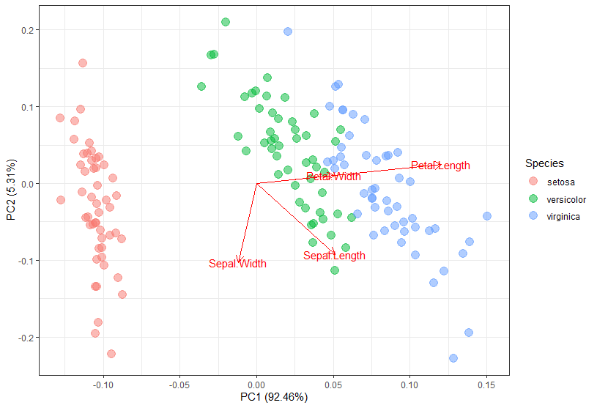
PCA
How does results “should” looks like
Normally most variation are captured by PC1 and PC2 so we can use them to replot our sample in two dimensions
Pull in the outliers by doing a log transformation of the continuous value
Work very well for morphometric analysis
e.g. can I determine which cellphone model I am looking at based on series of measures (width, height, thickness, size of the camera etc…)
www.cdcs.ed.ac.uk

Slide 7
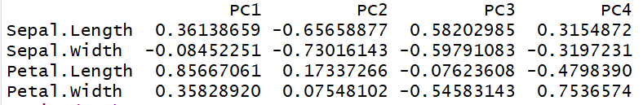

Read the variation: Loading Values
Pull in the outliers by doing a log transformation of the continuous value
Recepie
0.8566 Petal length
0.3613 Sepal length
0.3582 Petal width
0.0845 Sepal width
https://www.loveandoliveoil.com/2014/10/the-antioxidant-aperol-tangerine-cocktail.html
www.cdcs.ed.ac.uk

Slide 8
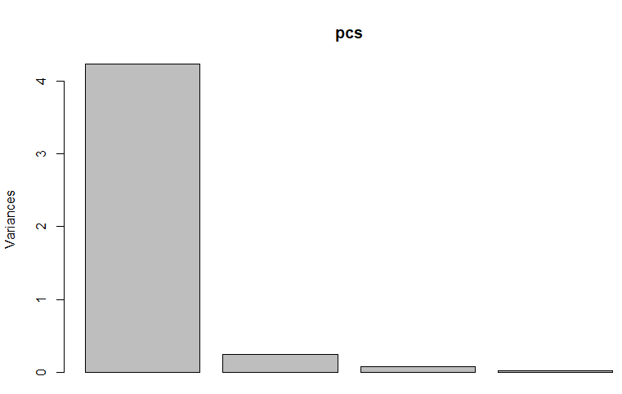
PCA Limitations
When you use PCA analysis you need to be sure that you are looking at the highest percentage of variation.
If the sum of PC1 and PC2 does not correspond to at least 90% of the total variances my result cannot be accurate
But you can still track variation on your data
Pull in the outliers by doing a log transformation of the continuous value
PC1
PC2
PC3
PC4
www.cdcs.ed.ac.uk

Slide 9
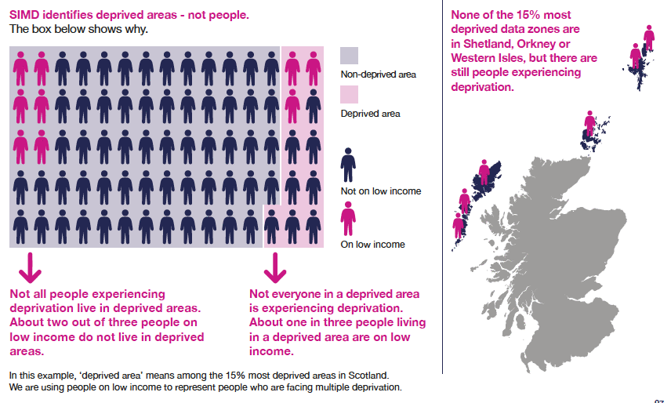
Now let see how it work on real data
Dataset 1 SIMD
Scottish Indexes of Multiple Deprivation
www.cdcs.ed.ac.uk

Slide 10
Now let see how it work on real data
Dataset 1 SIMD: what are we going to focus on
Variable | Description | Type
Income_rate | Percentage of people who are income deprived | PERCENTAGE
Employment_rate | Percentage of people who are employment deprived | PERCENTAGE
Attendance | School pupils attendance | PERCENTAGE
not_participating | Proportion of people aged 16-19 not participating in education, employment or training | PERCENTAGE
University | Proportion of 17-21 year olds entering university | PERCENTAGE
overcrowded_rate | Percentage of people in households that are overcrowded | PERCENTAGE
nocentralheat_rate | Percentage of people in households without central heating | PERCENTAGE
Broadband | Percentage of premises without access to superfast broadband | PERCENTAGE
Council_area | Council area | TEXT
www.cdcs.ed.ac.uk

Slide 11

Now let see how it work on real data
Dataset 2 Cost of Living
Ad Hoc dataset collecting information about the raising in the cost of living in Scotland
www.cdcs.ed.ac.uk

Slide 12
Now let see how it work on real data
Dataset 1 SIMD: what are we going to focus on: numerical variables
Variable | Description | Type*
Food Insecurity | Percentage of people that reported food insecurity (2017-2021 vs 2018-2022) | PERCENTAGE
Houses Prices | Average Cost of an house (£) | PERCENTAGE
Welfare Applications | Number of welfare applications | PERCENTAGE
Homeless Applications | Number of Homeless applications | PERCENTAGE
Rent | Average Rent of and house (£) | PERCENTAGE
authority | Council area | TEXT
location | Type of area Rural/Urban | TEXT
region | Part of Scotland | TEXT
* We need to calculate the percentage of increase/decrease
www.cdcs.ed.ac.uk

Slide 13
Clean Data
Dataset 1 SIMD
Dataset 2 Cost of Living
Subset only the variables we are interested on
Remove * and £ symbols
Re-encode the numeric variables as numeric
Remove null values
Flip University percentage to represent % of people that did not go to Uni
Group by constituency and get average of indicators by constituency
Extract numerical columns
Normalise
Plot correlation between variables
Remove £ and swap “,” for “.”
www.cdcs.ed.ac.uk

Slide 14

Any Question?
www.cdcs.ed.ac.uk

Slide 15
References
http://www.sthda.com/english/articles/31-principal-component-methods-in-r-practical-guide/118-principal-component-analysis-in-r-prcomp-vs-princomp/
https://cran.r-project.org/web/packages/ggfortify/vignettes/plot_pca.html
https://towardsdatascience.com/principal-component-analysis-pca-101-using-r-361f4c53a9ff
https://www.linkedin.com/learning/r-statistics-essential-training/conducting-a-principal-components-factor-analysis?autoplay=true&u=50251009
https://www.youtube.com/watch?v=FgakZw6K1QQ&t=985s
https://www.youtube.com/watch?v=0Jp4gsfOLMs
https://www.datacamp.com/tutorial/pca-analysis-r
www.cdcs.ed.ac.uk

